Slide 1
TSF with Keras and RNN
Submitted By: Deepak Sharma
Notes:
ID=d924773e-9a16-4d6d-9803-8cb819e99682 Recipe=text_billboard Type=TextOnly Variant=0 FamilyID=AccentBoxWalbaum_Zero

Slide 2
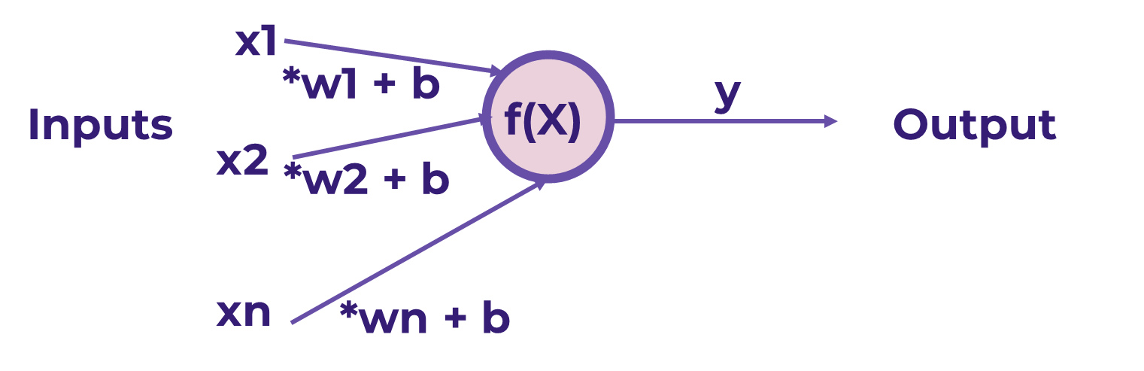
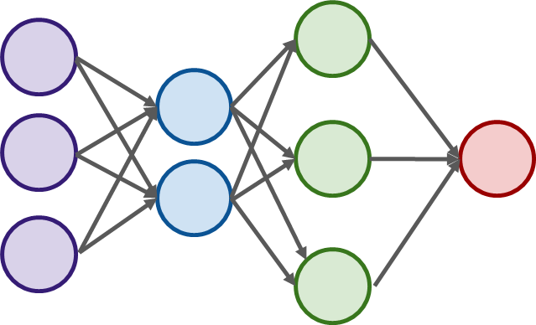
Introduction
Perceptron is a neural network unit (an artificial neuron) that does certain computations to detect features or business intelligence in the input data.
A neural network is a series of algorithms (perceptron) that endeavors to recognize underlying relationships in a set of data through a process that mimics the way the human brain operates. In this sense, neural networks refer to systems of neurons, either organic or artificial in nature.

Slide 3
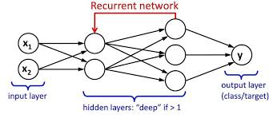
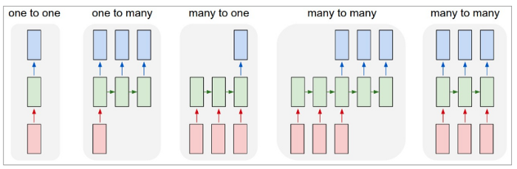
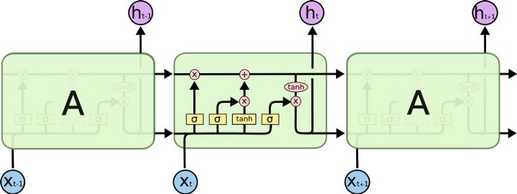
A Recurrent Neural Network (RNN) is a type of neural network that contains loops, allowing information to be stored within the network.
Recurrent Neural Networks use their reasoning from previous experiences to inform the upcoming events.
Recurrent models are valuable in their ability to sequence vectors, which opens up the API to performing more complicated tasks.
Types of RNN: one to one, One to Many, Many to Many,
Many to one, Many to Many.
A simple recurrent neural network works well only for a short-term memory.
Long Short-Term Memory (LSTM) networks are a type of recurrent neural network capable of learning order dependence in sequence prediction problems.
LSTM networks are a type of RNN that uses special units in addition to standard units.
LSTM units include a 'memory cell' that can maintain information in memory for long periods of time.

Slide 4
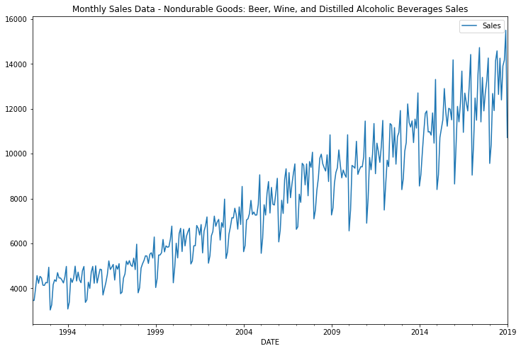
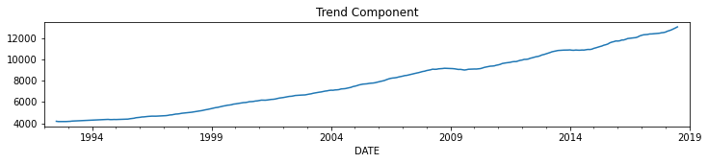
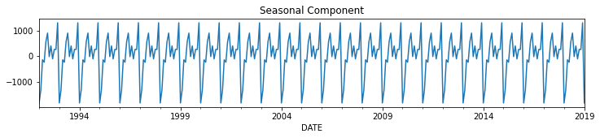
Data: The Data contains monthly sales data of Beer, wine and Distilled Alcohol beverage for the year 1992 to 2019.
Plot: From the plot we can se there is some sort of Seasonality and Trend Component in the Data.
Seasonal Decomposition: We will Decompose the Data into separate components i.e. Trend, Seasonality, Noise.
Train-Test Split:
We will Train our Neural Network on the Training Data.
we will Forecast for the Test Data and Compare the Results with the Actual Values.
We will train our model for 26 years of Data and will forecast for the next 1 year.
Scaling:
In Neural Networks As we calculate the Biases and weight, If your data is skewed, i.e. there is a huge difference between the minimum and Maximum value (In our Data the min is 4000 and max 15000), neurons get confused on what sort of values to be used for weights and Biases.
We will only fit the Scaler model to our Train Data, Other wise we are Cheating assuming Info about our Test data.
Time Series Generator:
For Training the Neural Network we need to feed the Data in form of Batched along the Labels. [t1,t2,t3] --> [t4].
This class takes in a sequence of data-points gathered at equal intervals, along with time series parameters such as stride, length of history, etc., to produce batches for training/validation.

Slide 5
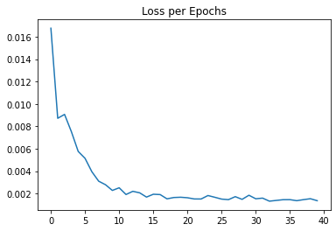
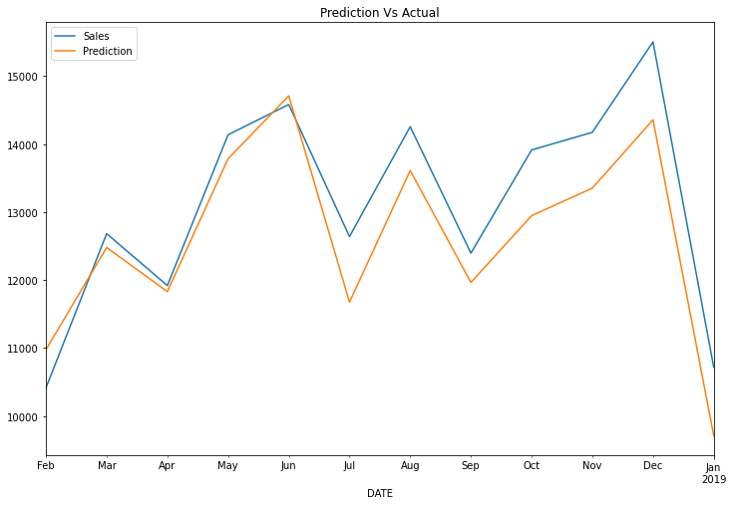
Creating A Model:
We will use Keras Models to create a Sequential Neural Network.
First Layer is of LSTM with 150 Neurons and ReLU as activation Function.
Second Layer is of Dense to aggregate all neurons into single Prediction.
We will train the Model for 40 epochs.
1 epochs is equal to single entire run through of all your training data.
Evaluating The Model:
Our RNN Model predict One time stamp Ahead, i.e. basically, our network recall 12 history steps and predict the step 13.
We need the Last 12 points of the training Data to predict he point 1 of the Test Data.
And we will continue this cycle to predict further in the test data.
Inverse Transformation and Comparing the Prediction:
We will De Scale the Test Prediction and Compare the actual and predicted values.

Slide 6
Thanks

